Slide 1
Product Highlight : Cobra JumPack™
The following deck will provide you with the information and tools you need to successfully increase sales and market share for The Cobra JumPack™.
Contents:
Cobra JumPack™ Product Pitch
Channel Positioning
Marketing Sales Support
Product Pages
Approved Images and Logos

Slide 2
Product Pitch: JumPack™
The following slides include highlighted features, copy points and images that comprise our product pitch for JumPacks™. Please use the slides to effectively communicate the features and benefits of our JumPacks™.

Slide 3
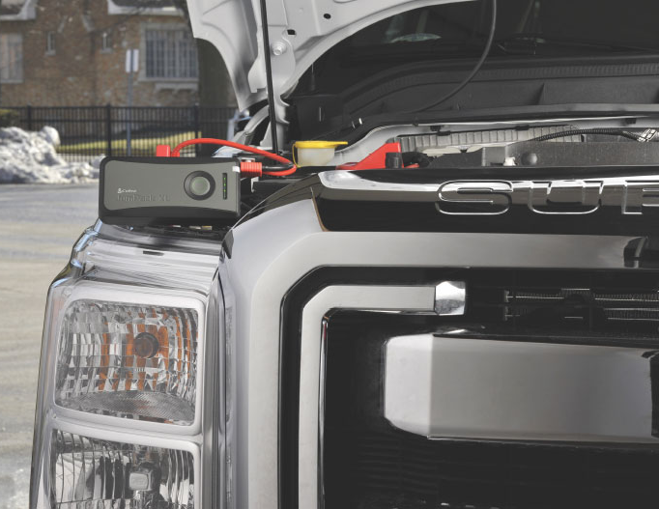
Cobra JumPack™
“Seriously, can that little thing jump start a car?” The answer is YES.
What if you could jump start a car, light-duty truck, or van and charge mobile devices with a battery pack that fits in your backpack or glove compartment? The Cobra JumPack™ models do all of that and more. With a starting current of up to 360 peak Amps, the Cobra JumPack™ series has enough power that it could even jump start multiple vehicles on a single charge, including light duty trucks, RV’s and diesel engines.
These compact, portable power packs contain a UL-registered Lithium-Cobalt battery and USB output(s) to rapidly charge smart phones, tablets, and digital cameras or any USB powered device. It’s the ideal emergency battery pack for home, office, vehicle or the outdoors.

Slide 4
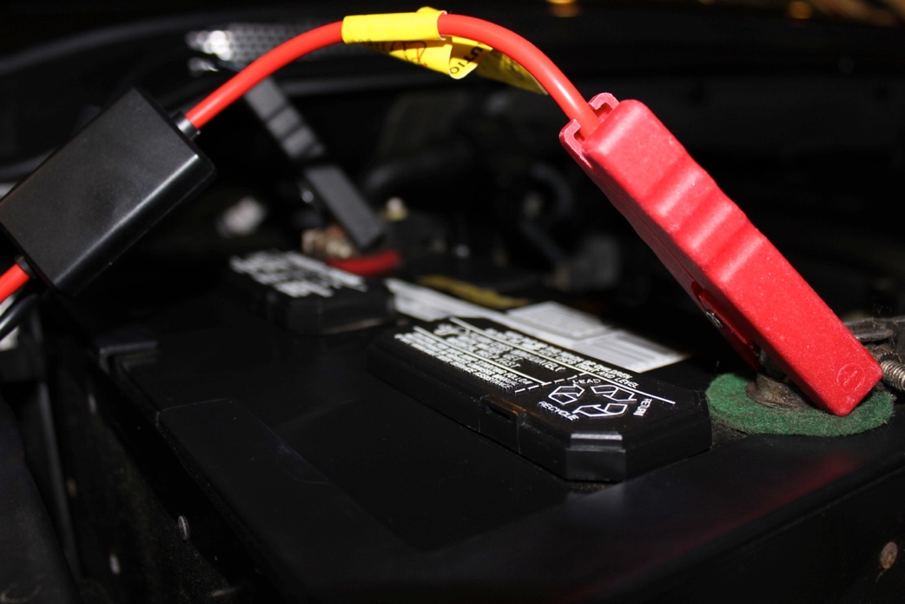
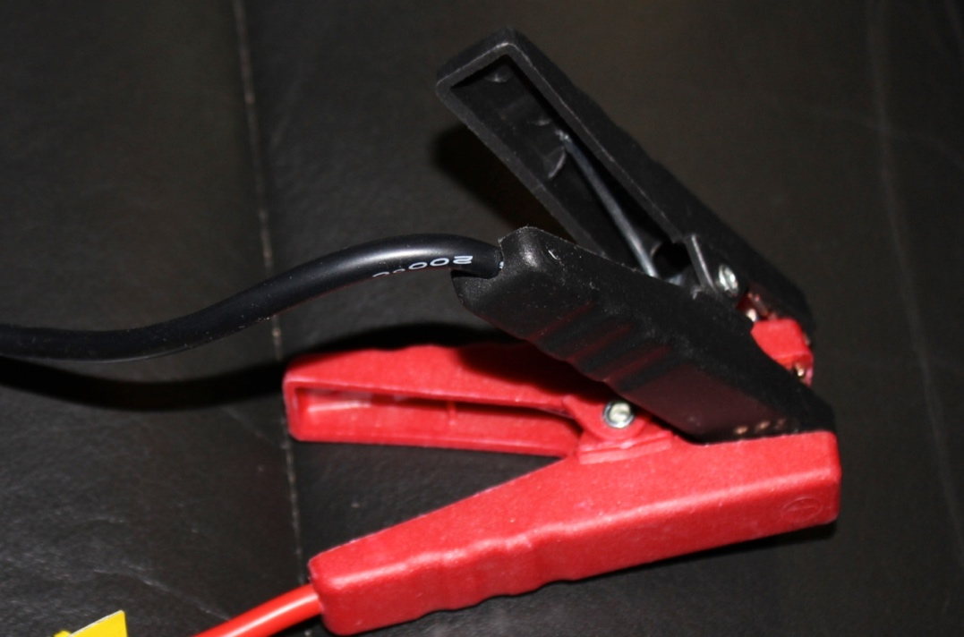
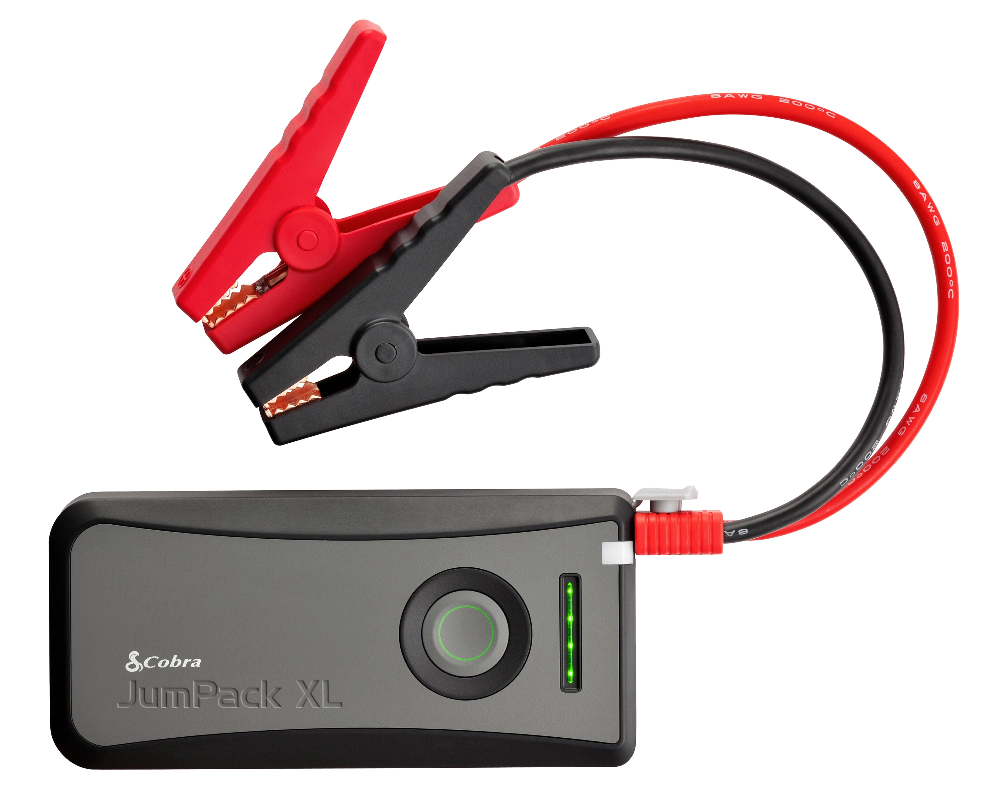
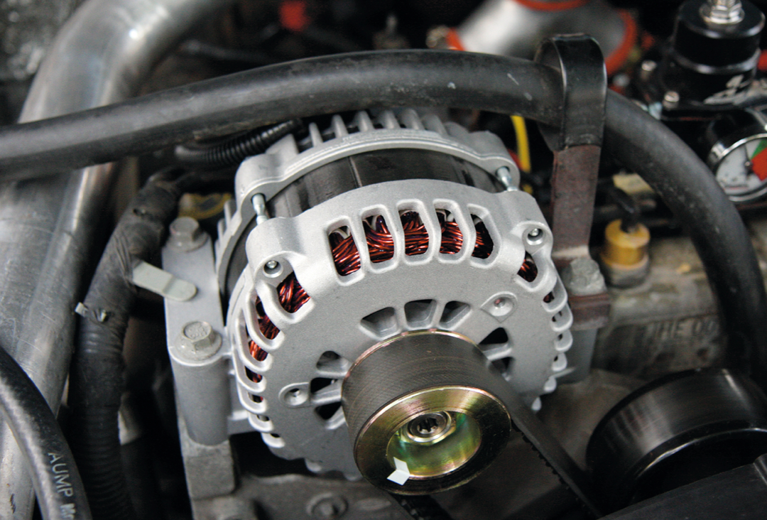
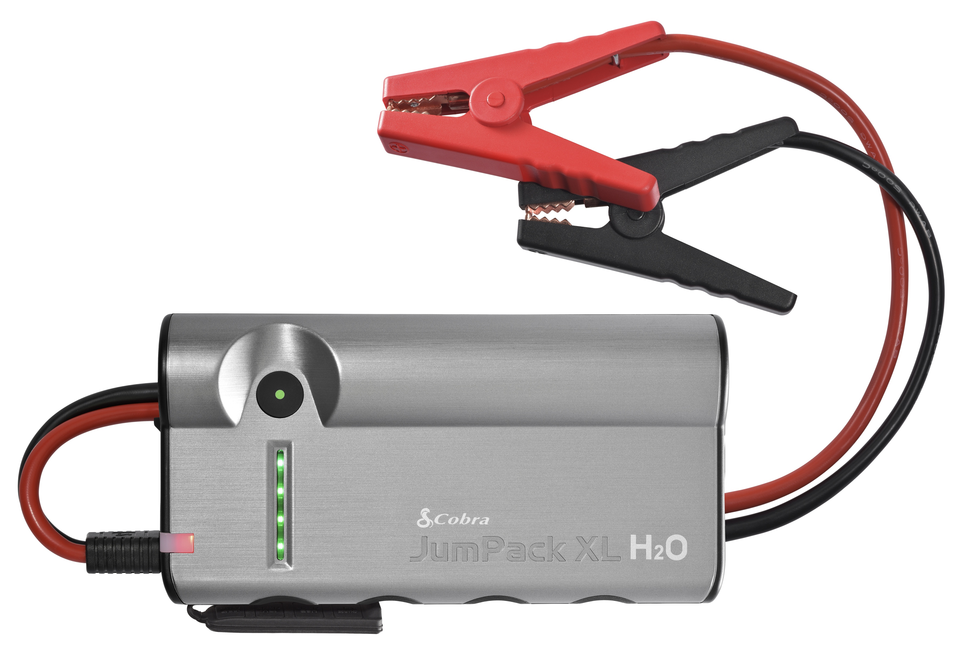
Cobra products are better quality products with enhanced safety features, which is essential in an emergency.
Customers want a quality product:
JumPacks™ must be reliable and safe. Cobra JumPacks™ outperform the competition, and spec for spec give the customer a better product.
Customers expect a value:
Cobra JumPack’s line provides built in features, carrying case and accessories, and the best price for the quality. With the ability to jumpstart both gasoline and diesel engines, every customer can find value in owning a JumPack.
Reverse Polarity Protection
Short Circuit Protection
Over Charge Protection
Reverse Charge Protection

Slide 5
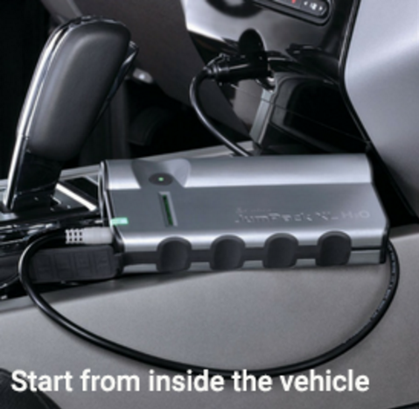
JumPack XL H20 12 Volt Port
Why CPP 15000?
The JumPack XL H20 offers a secondary Jumpstart option from the traditional jumper cables. The car can be jump started through the 12-volt port inside the car. An option that considers weather conditions and safety when jumpstarting your car. The 12-volt car charging option takes up to 15 minutes.
LED | CONDITION
No LED | Connection not detected or the JumPack battery is depleted.
RED | Car charging failed. Vehicle ignition switch needs to be in Accessory position.
RED | FLASH – The vehicle battery is too discharged for the JumPack to charge is sufficiently.
RED - FLASH and FLASH GREEN LIGHT BAR | The JumPack internal battery is nearly depleted. Charge the JumPack
YELLOW - FLASH | The JumPack is charging the car battery.
YELLOW - FAST FLASH | Charging almost complete
GREEN | Try to start your vehicle.

Slide 6
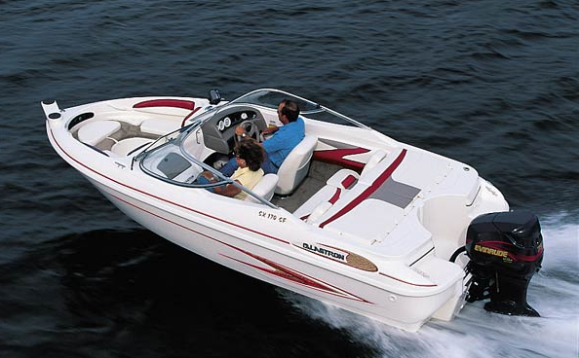
Channel Positioning
Like all our product, Cobra JumPacks™ can be positioned in all our Sales Channels.
Channel | Target Markets
Outdoor Channel | Recreational Adventurer Hiker and Camper ATV / UTV Sports Off-Roading
Marine Channel | Outboard Engine Boats (H20)
Car Channel | Commuters Parents of drivers Female drivers
Professional Driver | Uber / Lyft drivers Gifts for Family

Slide 7
Marketing Sales Support
Retail Displays, Signage, brochures, leave-behinds and presentations for retailers: the Marketing team will provide you the collateral you need to ensure a successful sale.

Slide 8
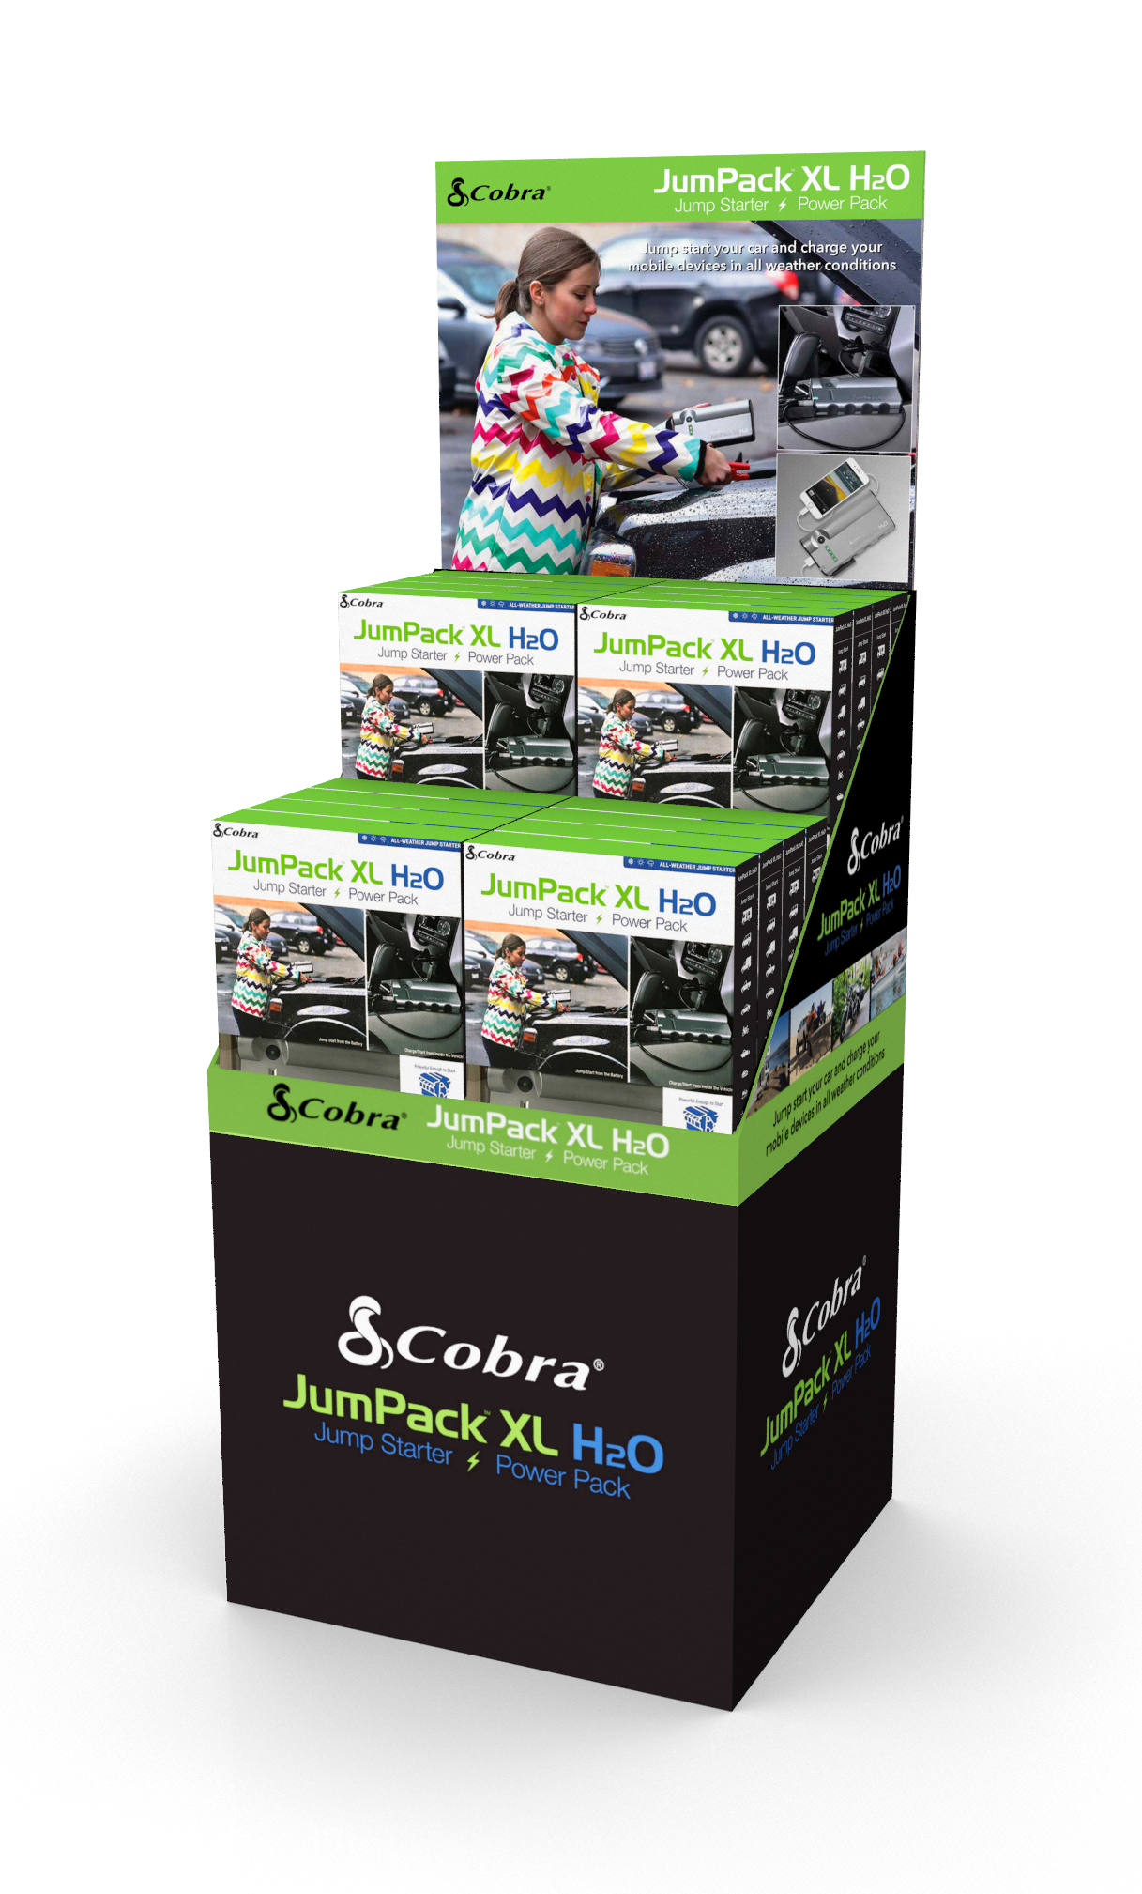
Retail Sales Support: In-store Collateral
To support our retail partners, the Marketing design team will provide display units as well as in-store point of sale collateral. These materials should be made available to our retail partners.
New Product Displays
¼ Pallet Sidekick (free standing)
Video display unit for JumPack
POP
Posters
Shelf Talkers
Planogram Presentations available upon request
We can provide print-ready files to any retailer to reformat into their specific signing, or design new collateral upon request.

Slide 9
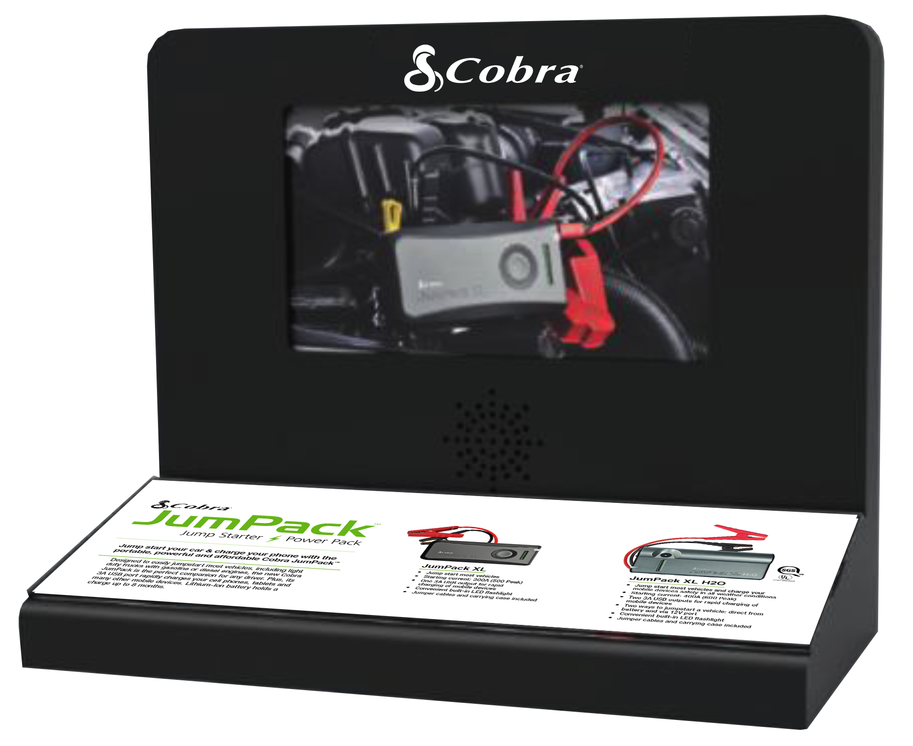
Retail Sales Support: In-store Collateral
The Marketing team can provide these ready-to-ship displays OR come up with the perfect display for your specific retailer. Contact Marketing@cedarelectronics.com for requests.
Display Features | ¼ pallet | Video Display
Holds 16 JumPacks | X
Customizable header card on request | X
Optional Product Mix with Power Inverters | X
Updated Video display with customizable insert card |  | X

Slide 10
How to Order Display Units
The Marketing team can provide these ready-to-ship displays OR come up with the perfect display for your specific retailer. Contact Marketing@cedarelectronics.com for requests.
Order Process
Video Displays | Follow the same process as you would if you were ordering product against your sample accounts
Custom Displays | For custom displays email marketing@cedarelectronics.com with your request: Subject Line = DISPLAY + Order Number Include the total quantity requested and in-store date Allow a minimum of 4 weeks from order to shipment to retailers Include contact information for follow up conversations, including shipment address

Slide 11
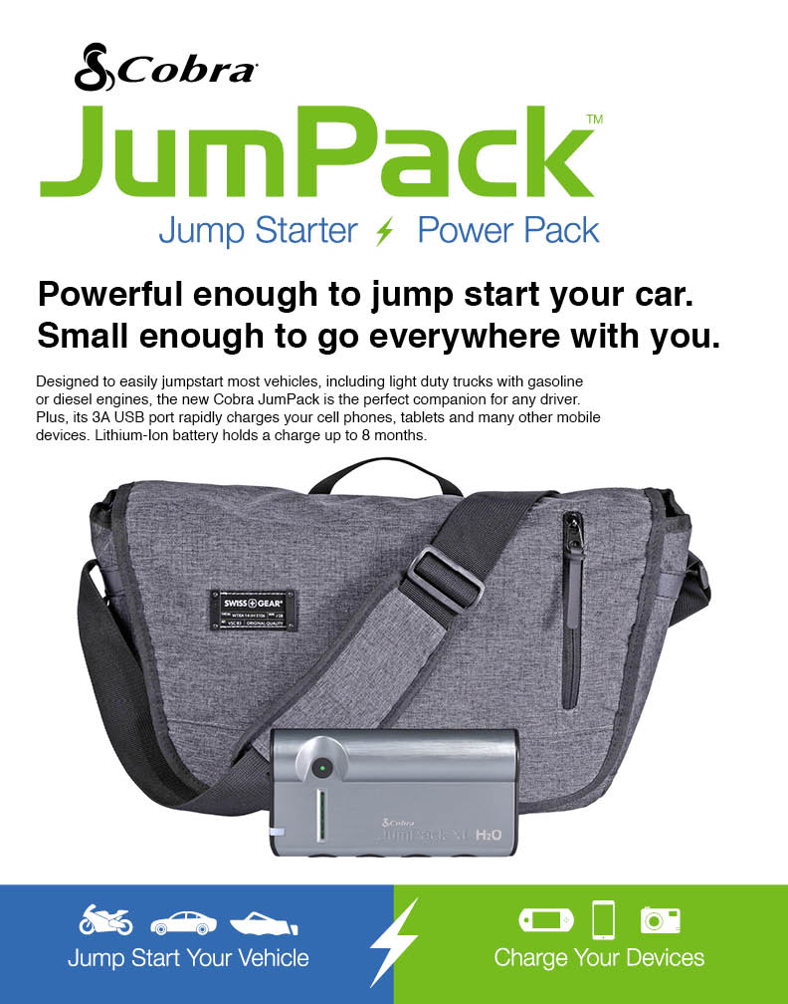
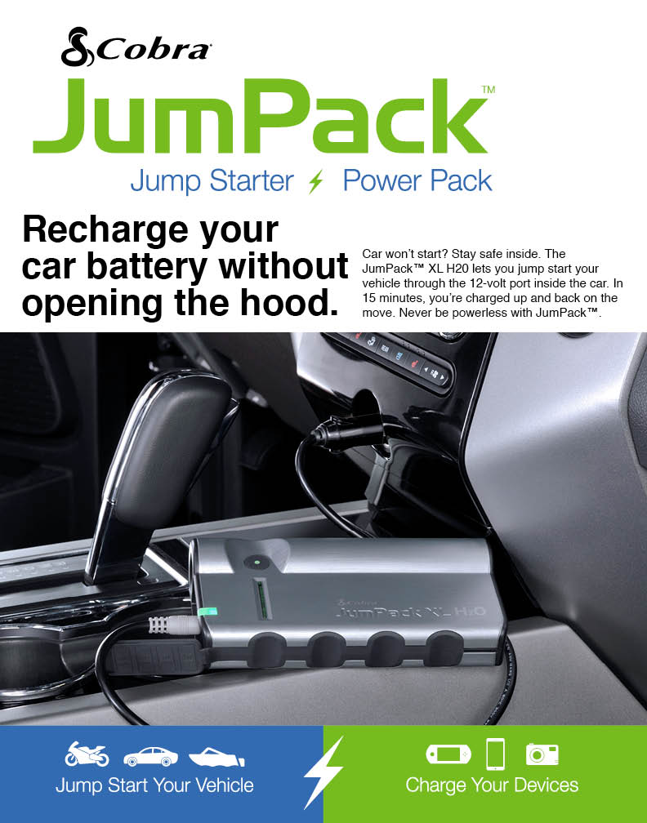
Retail Sales Support: Signage
The Marketing team can already-designed signage OR come up with the perfect display for your specific retailer. Contact Marketing@cedarelectronics.com for requests.
Signing Types
Point of Sale Signing: Posters
Point of Sale Signing: Shelf Talkers

Slide 12
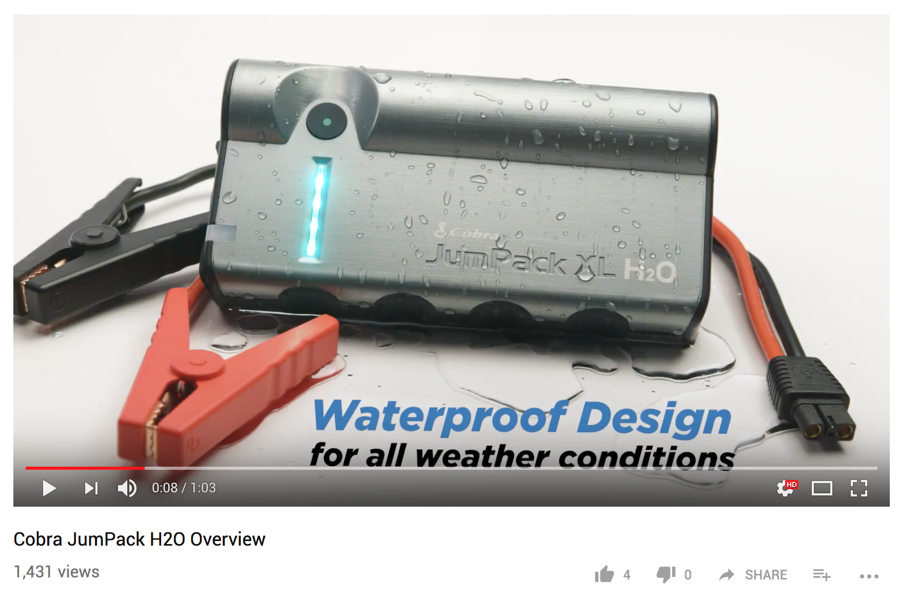
Retail Sales Support: Video
https://www.youtube.com/watch?v=6Ck8Eeop76k
Learn about the features of Cobra's newest JumPack, the JumPack XL H20! Designed to jump start large V8 gasoline and diesel engines, the new JumPack™H2O is UL listed and will keep you going in all-weather conditions

Slide 13
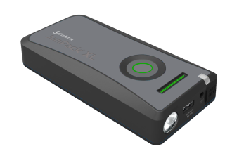
Marketing Sales Support: Comparison Charts
Make your sales presentation have impact with a comparison chart- contact Marketing@cedarelectronics.com to have one made tailored to your retailer.
Costco example below:
Competitor Model HERE
Model | Competitor Model | JumPack™ XL- CPP12000 | JumPack™ XL H2O- CPP15000
Jump Starts |  | All 4,6,8 cylinder gas and diesel vehicles | All 4,6,8 cylinder gas and diesel vehicles
Jump Start Current |  | 300A | 400A
Jump Start Peak Current |  | 500A | 600A
Battery Capacity |  | 41.1 Watt Hours | 44.4 Watt Hours
USB Output Current |  | 1X 3A | 2X 3A
Jump Start Methods |  | Direct to Battery | Direct to Battery & Easy 12V Port
Casing Material |  | Insulated ABS | Insulated ABS
Jump Start Status/Safety Indicator |  | Built-in Tri-color LED | Built-in Tri-color LED
Protection Circuitry |  | Reverse Polarity, Short Circuit, Over Charge, Reverse Charge, Over Temp, Faulty Battery | Reverse Polarity, Short Circuit, Over Charge, Reverse Charge, Over Temp, Faulty Battery
Work light Functions |  | Flashlight , Strobe, SOS | Flashlight , Strobe, SOS
Included Accessories |  | Yes CLP and Wall Adapter | Yes CLP and Wall Adapter

Slide 14
Product Pages
The following slides can be used or modified for sales presentations.

Slide 15
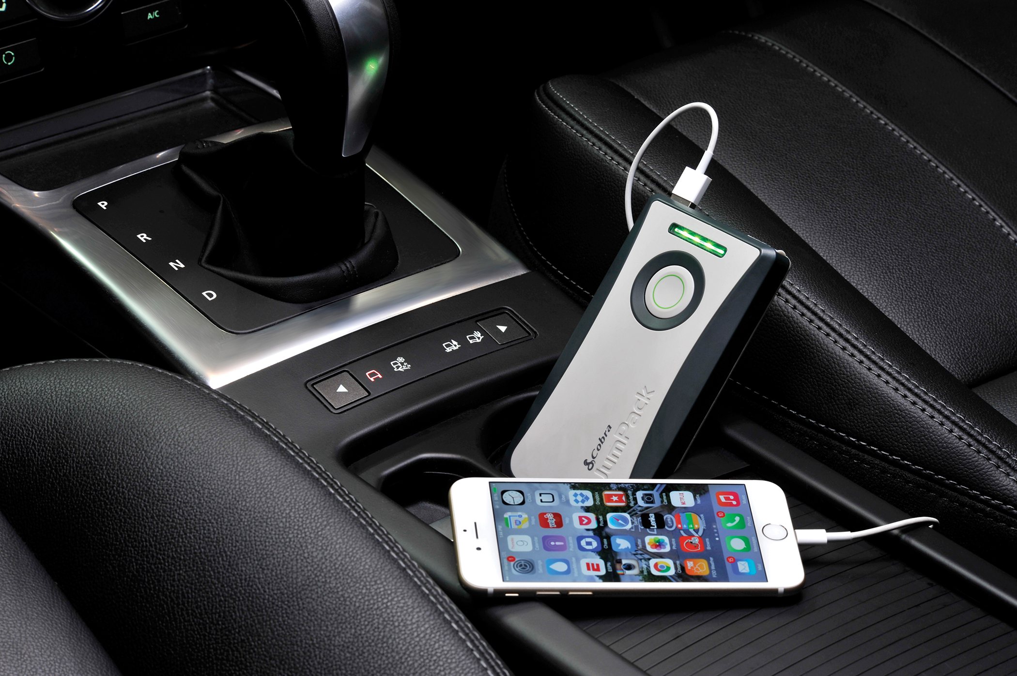
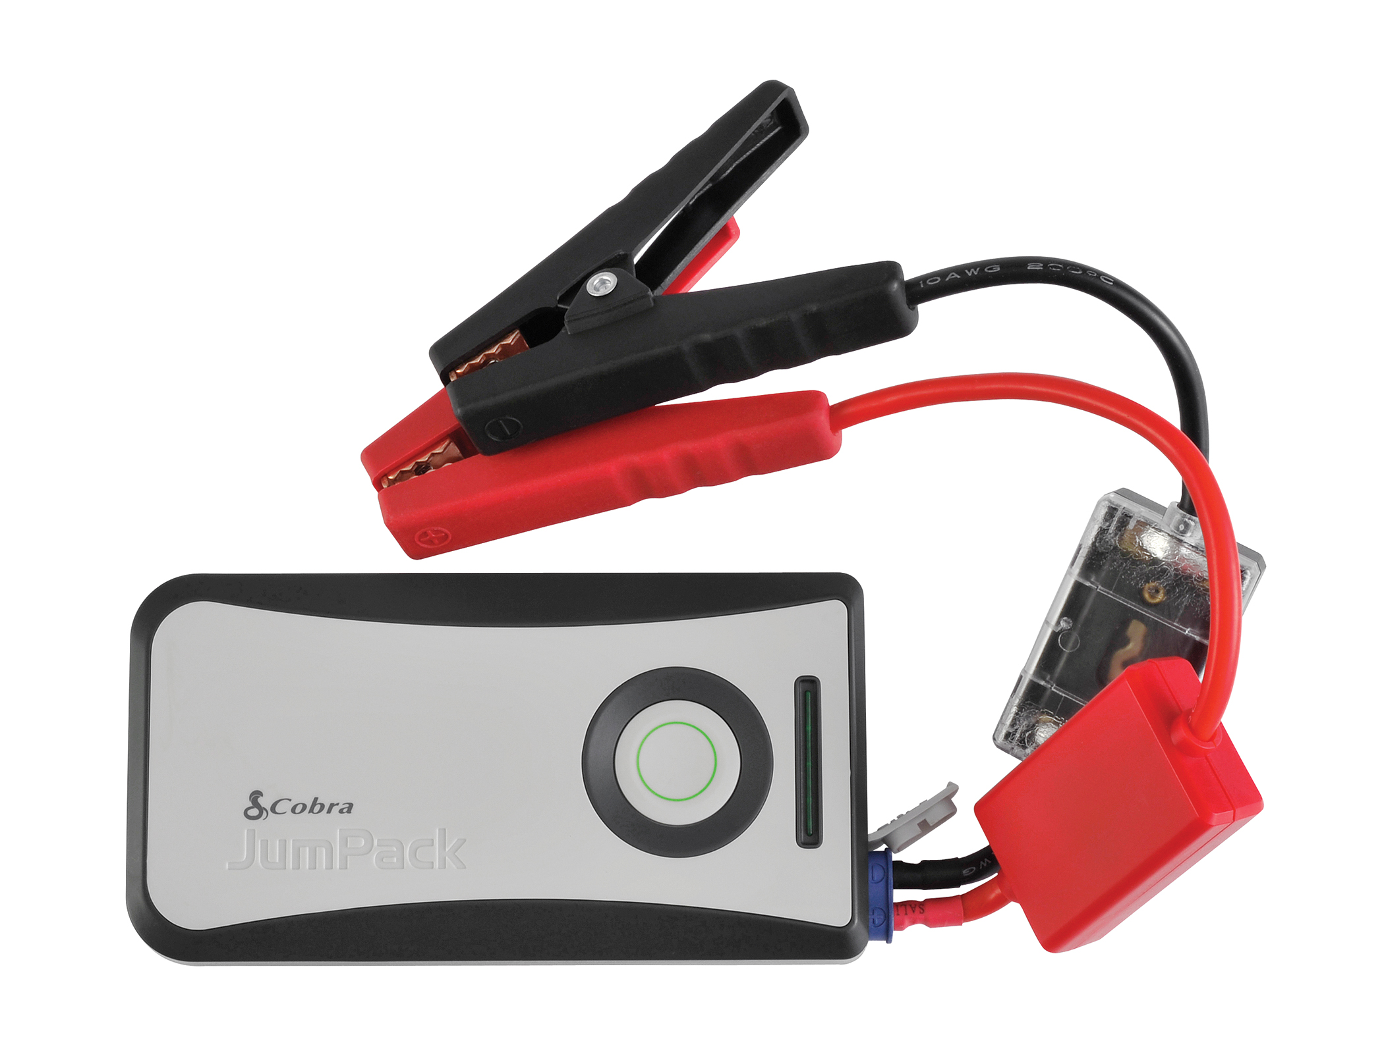
Cobra JumPackTM CPP 8000
Why CPP 8000?
You can power up both your phone and car batteries with the Cobra JumPack CPP 8000. Small enough to carry it with you anywhere you go, easily stowing it away in a handbag, briefcase, or even a pocket and weighing in at just under 10 ounces, it is one of the most-compact and portable power packs while offering dual capabilities of mobile-device charging and vehicle jumpstarting, including a range of cars, SUVs, motorcycles, outboard boat engines, etc. multiple times.
CPP 8000 Features:
180 Amp Starting Current, 360 Amp Peak Current - Jumpstarts most cars multiple times on a single charge
2.4 Amp USB Port for Rapid Charging - Quickly charge your cell phone, smartphone, tablets and other mobile devices multiple times
Built-in LED Flashlight - Super-bright work and emergency LED light.
6000mAh Lithium-Cobalt Battery - Holds a charge longer and is smaller than traditional jump starters.
Cobra JumPack CPP 8000
Cost | PLACE COST HERE $
Retail MAP | $99.95
Retail MSRP | $119.95
Individual Box Dimensions | 10.25” H x 7.25” W x 2.25” D (260.35mm x 184.15mm x 57.15mm)

Slide 16
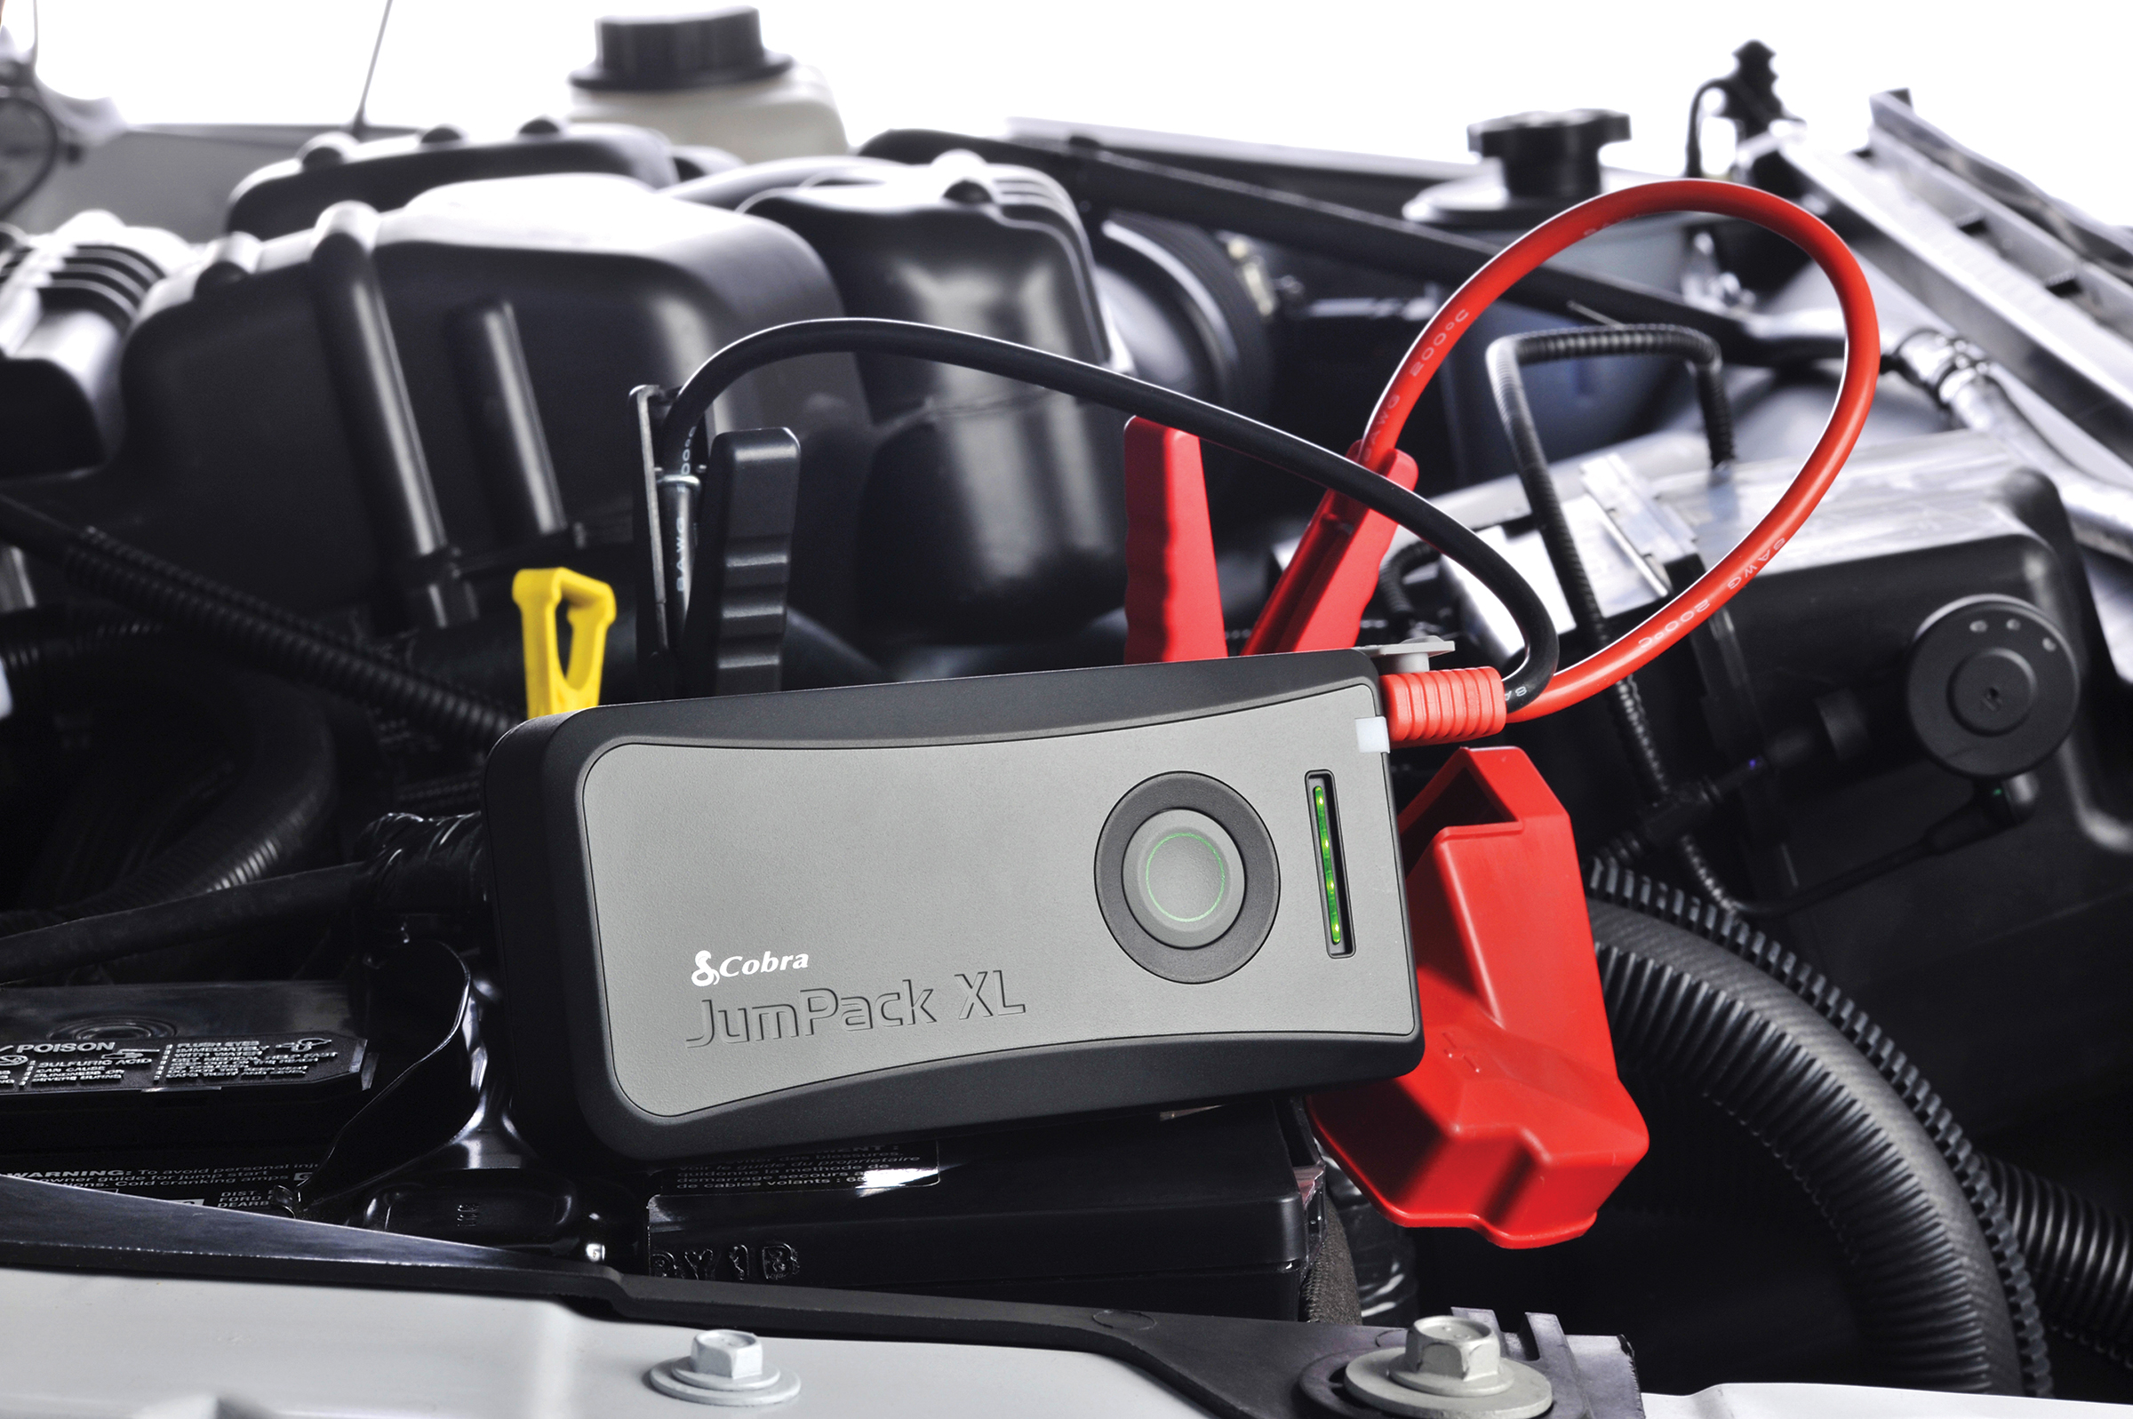
Cobra JumPackTM XL CPP 12000
Why CPP 12000?
With a starting current of 300 and 500 peak Amps, the Cobra JumPack XL has enough power to jump start most gasoline and diesel cars, light-duty trucks and cargo vans multiple times on a single charge. This compact, portable power pack also contains a UL-registered 41.1Wh (11,100mAh) battery with a 3 Amp USB output to rapidly charge any 5 Volt portable devices from smart phones to tablets to digital cameras, and many other devices, making it the ideal emergency battery pack for home, office, vehicle or the outdoors.
CPP 12000 Features:
300 Amp Starting Current, 500 Amp Peak Current - Jump starts most gasoline and diesel engine passenger, and light duty vehicles.
3 Amp USB Port for Rapid Charging of Portable Devices - Quickly charge your cell phone, smartphone, tablets and other 5V mobile devices.
Built-in LED Flashlight - Super-bright work LED, SOS and Strobe light.
UL Registered 41.1Wh Lithium-Cobalt Battery - Holds a charge longer and is 90% smaller than traditional jump starters.
Jump starts your vehicles and charges your mobile devices - Multiple times on one charge.
Cobra JumPack XL CPP 12000
Cost | PLACE COST HERE $
Retail MAP | $129.95
Retail MSRP | $149.95
Individual Box Dimensions | 10.43” H x 7.48” W x 2.36” D (2.65mm x 190mm x 60mm)

Slide 17
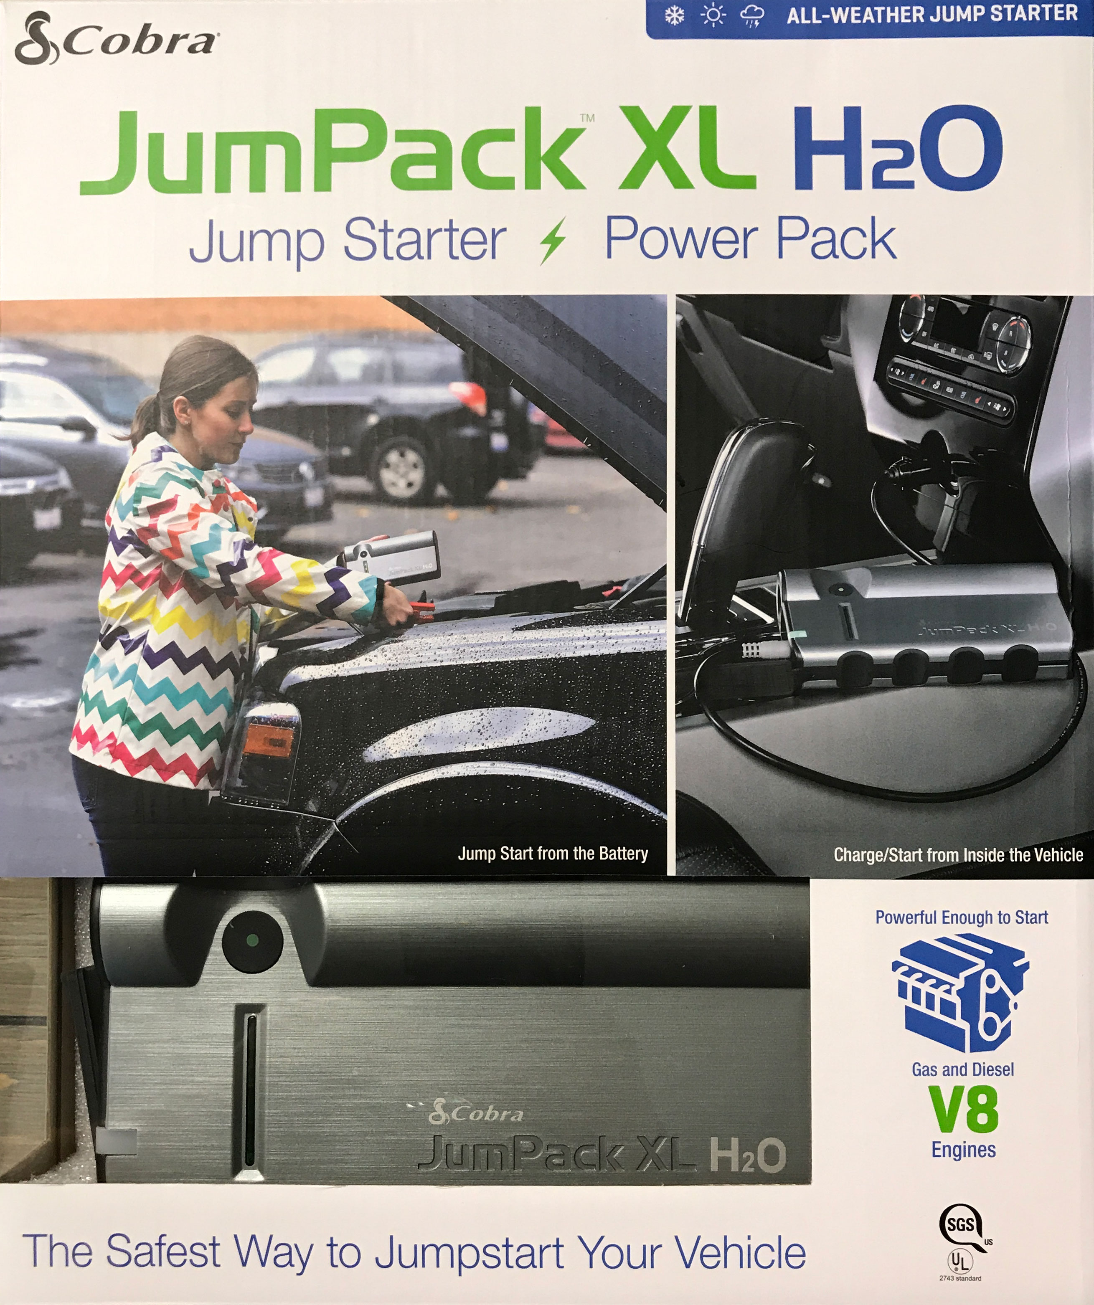
Cobra JumPackTM XL H20 CPP 15000
Why CPP 15000?
Designed to jump start large V8 gasoline and diesel engines, the new JumPack™H2O is UL listed and will keep you going in all-weather conditions. Features two ways to jumpstart a car, one using the traditional jumper cables and a secondary option that allows the vehicle to be started through the 12-volt port (CLP) inside the car for a simple, non-intimidating jump start. This compact UL 2347 certified portable power pack contains a powerful 44.4Wh (12,000mAh) battery with dual 3 amp each USB outputs to rapidly charge two 5 Volt portable devices simultaneously making it the ideal emergency battery pack for home, office, vehicle or the outdoors.
CPP 15000 Features:
400 Amp Starting Current, 600 Amp Peak Current- Jump starts most gasoline and diesel engine passenger, and light duty vehicles in all weather conditions.
Two Jump Start Options: Direct from the battery and from inside the vehicle’s 12 Volt port (CLP).
12000 mAh, 44.4 Wh UL Registered Lithium Cobalt Battery- Holds a charge longer and is smaller than traditional jump starters.
Dual 3 Amp USB Ports- Quickly charge two portable devices simultaneously.
Built-in LED Flashlight- Super-bright Flashlight, Strobe and SOS LED.
Cobra JumPack XL H20 CPP 15000
Cost | PLACE COST HERE $
Retail MAP | $149.95
Retail MSRP | $169.95
Individual Box Dimensions | 12.32” H x 10.55” W x 2.36” D (312.93mm x 267.97mm x 59.94mm

Slide 18
Approved Images and Logos
When creating any branded materials for presentation, please use the correct logos and product imagery. Please scale correctly and do not distort the imagery. Lo-res imagery for presentations / Microsoft Office Program can be copied and pasted from this PowerPoint. Hi-Res imagery is available for download on the sales gateway.

Slide 19
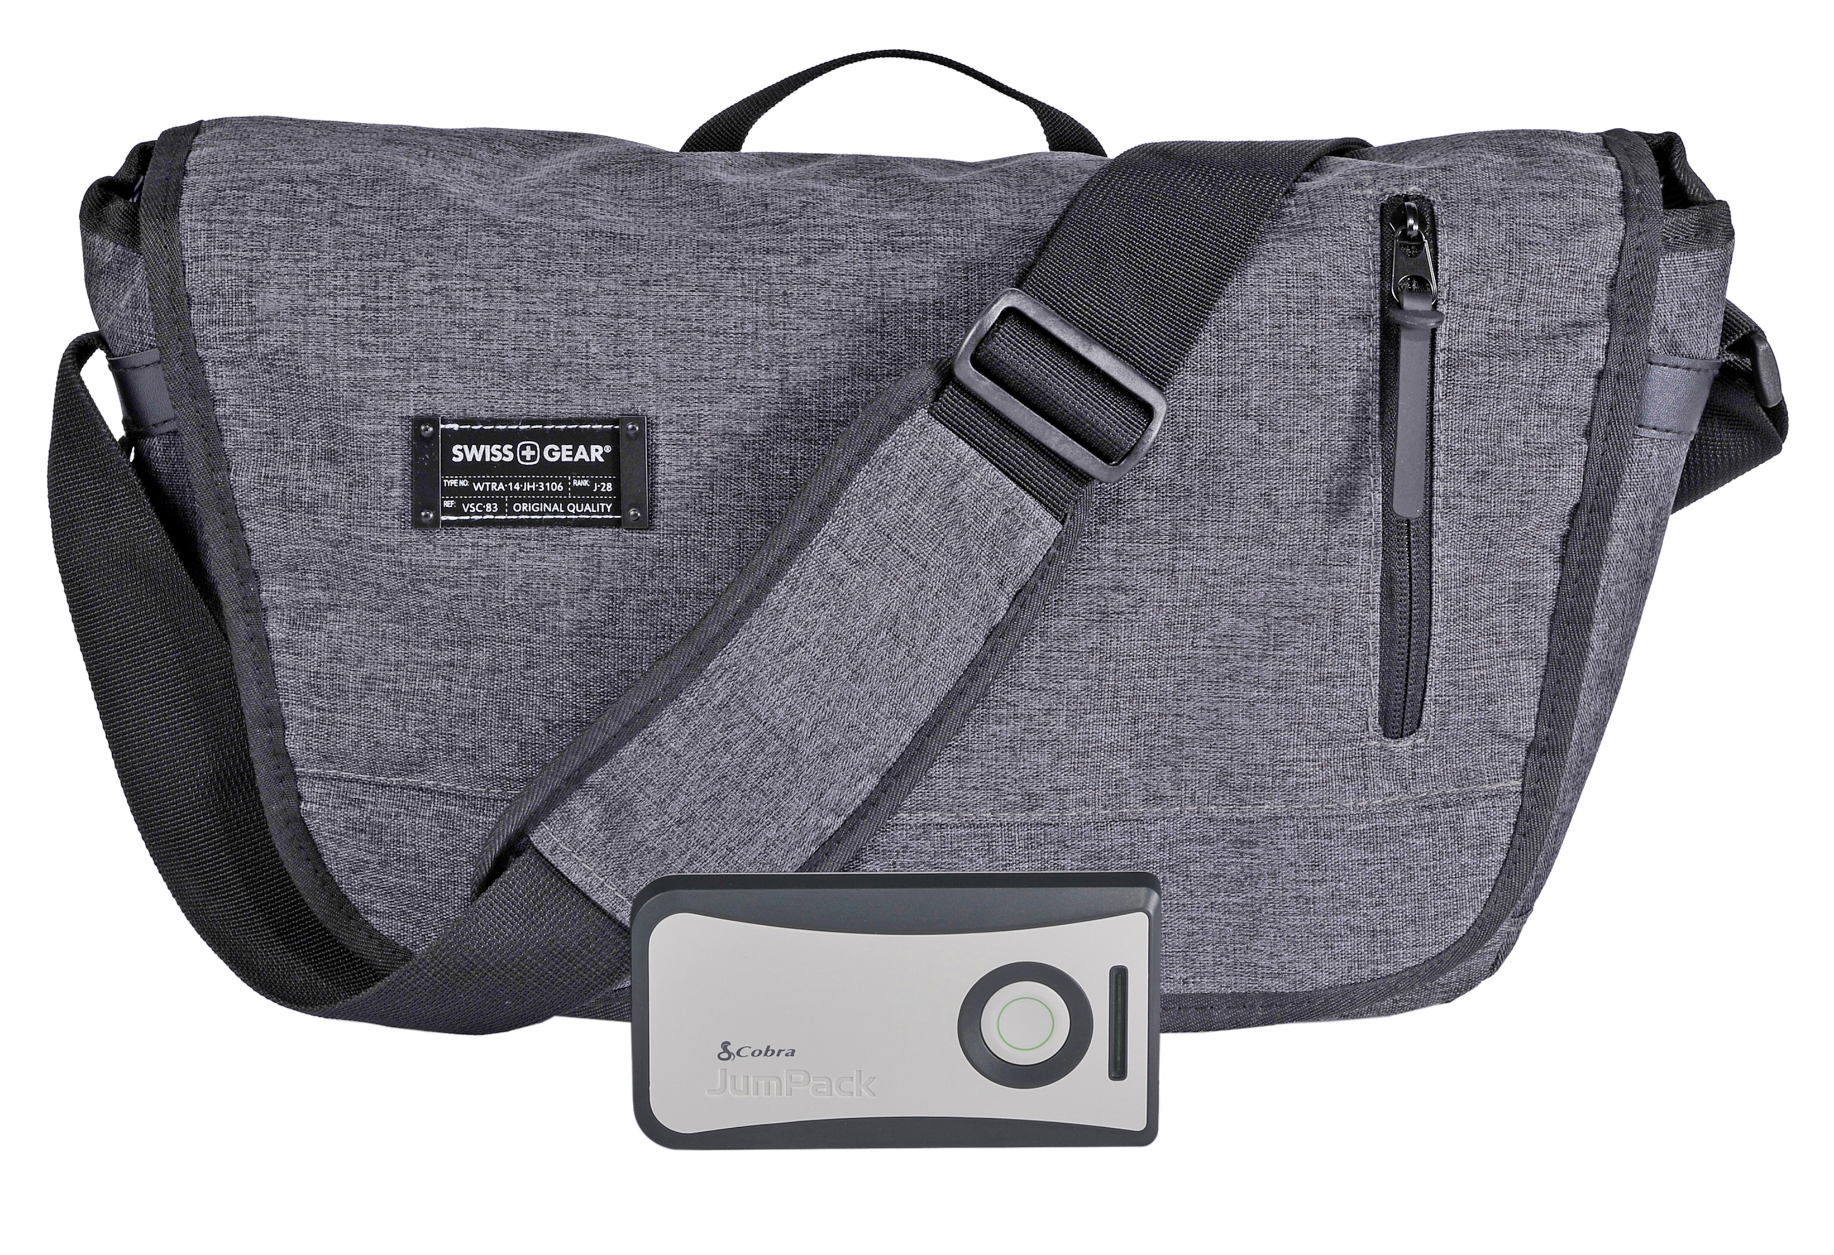
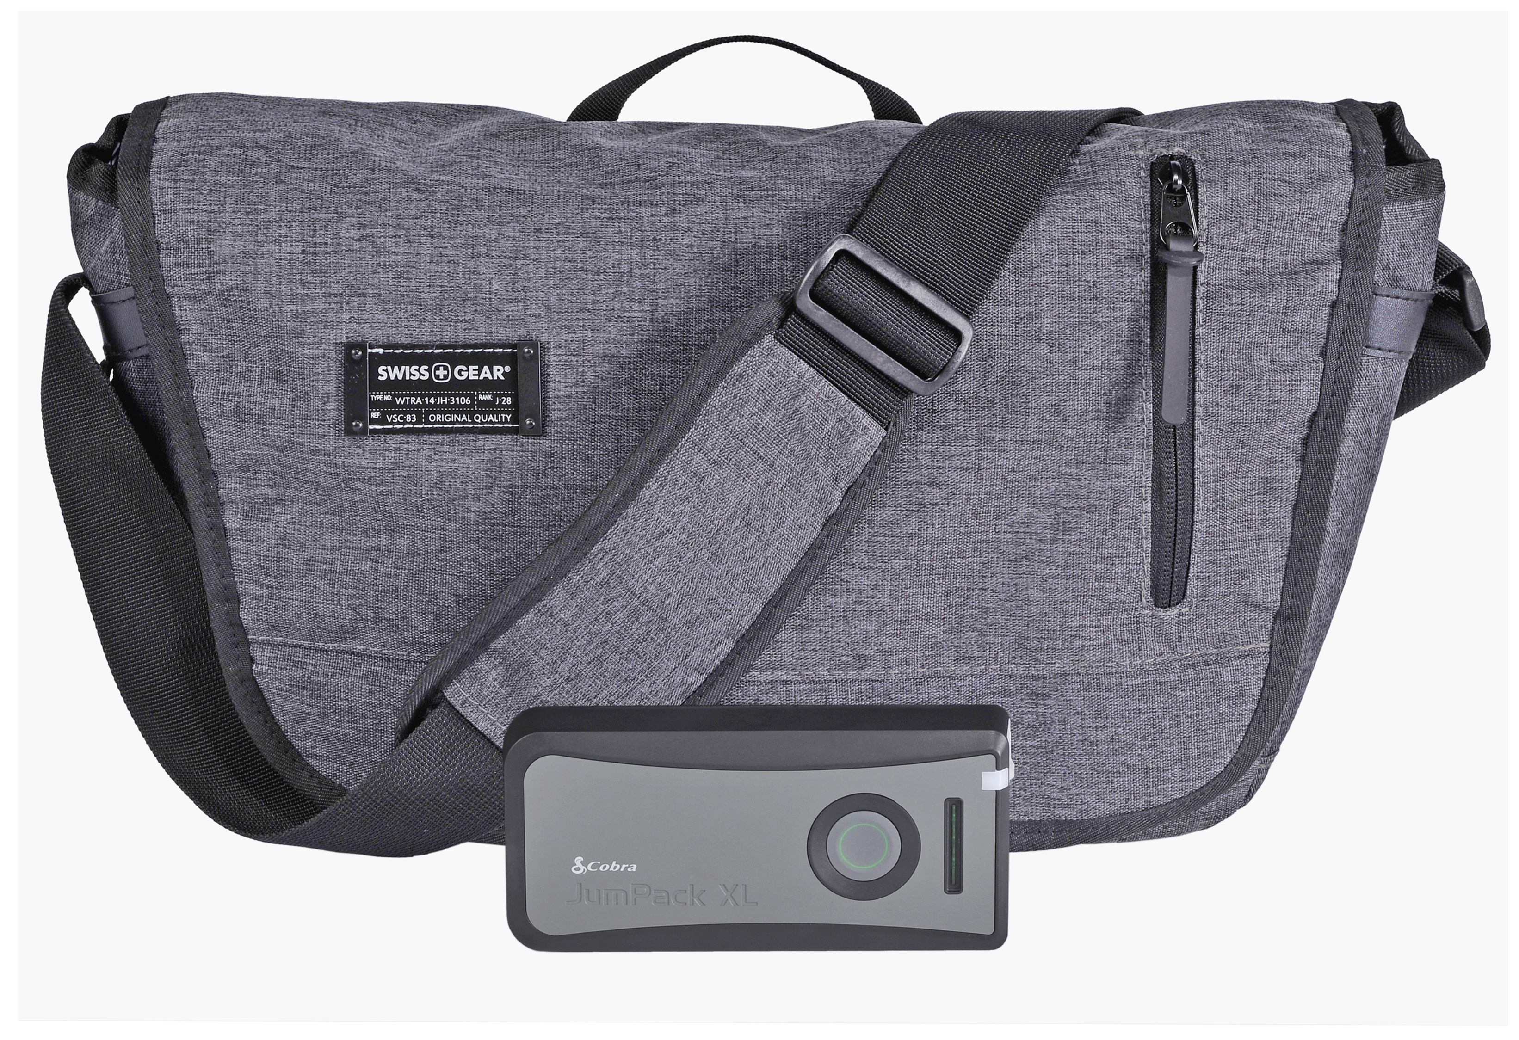
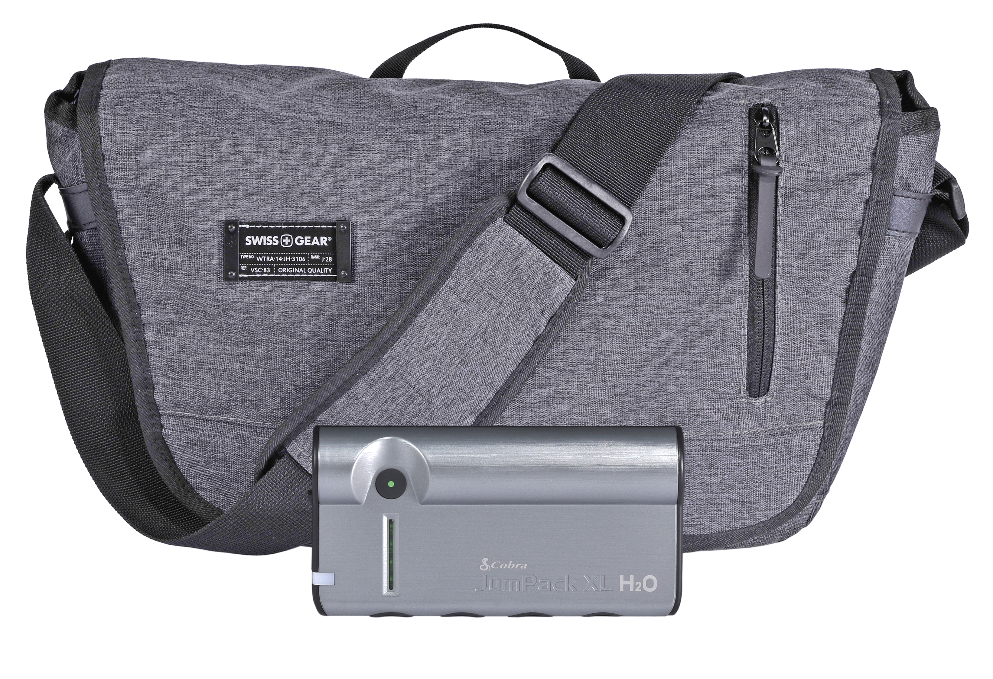
When creating any branded materials for presentation, please use the correct logos and product imagery. Please scale correctly and do not distort the imagery. Lo-res imagery for presentations / Microsoft Office Program can be copied and pasted from this PowerPoint. Hi-Res imagery is available for download on the sales gateway.

Slide 20
When creating any branded materials for presentation, please use the correct logos and product imagery. Please scale correctly and do not distort the imagery. Lo-res imagery for presentations / Microsoft Office Program can be copied and pasted from this PowerPoint. Hi-Res imagery is available for download on the sales gateway.

